Slide 1
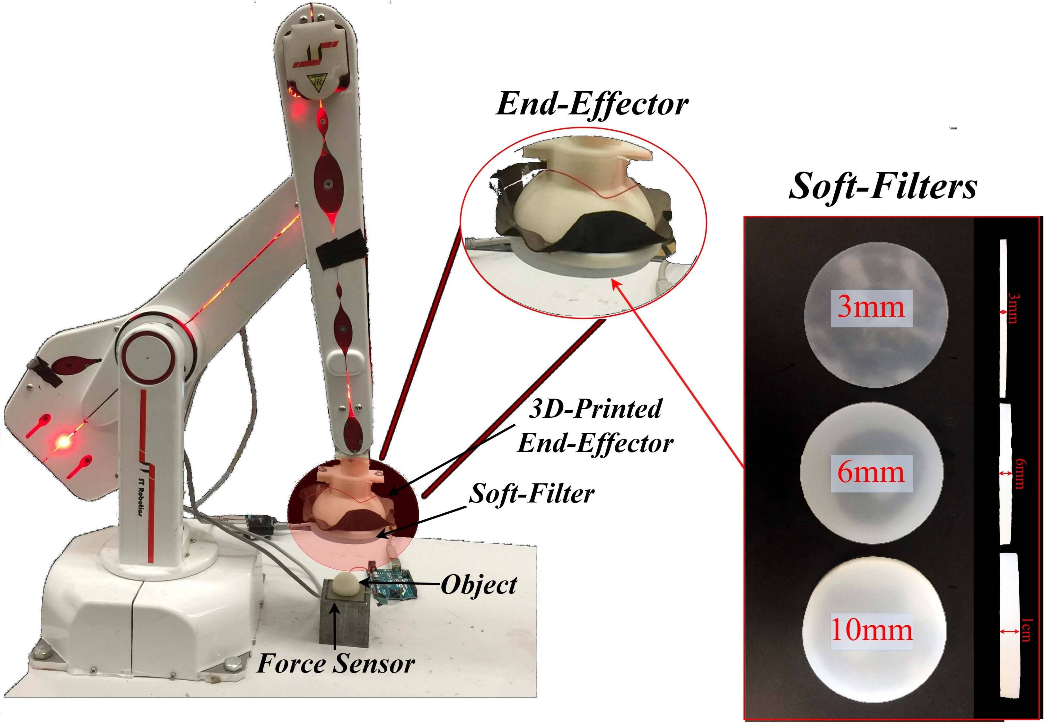
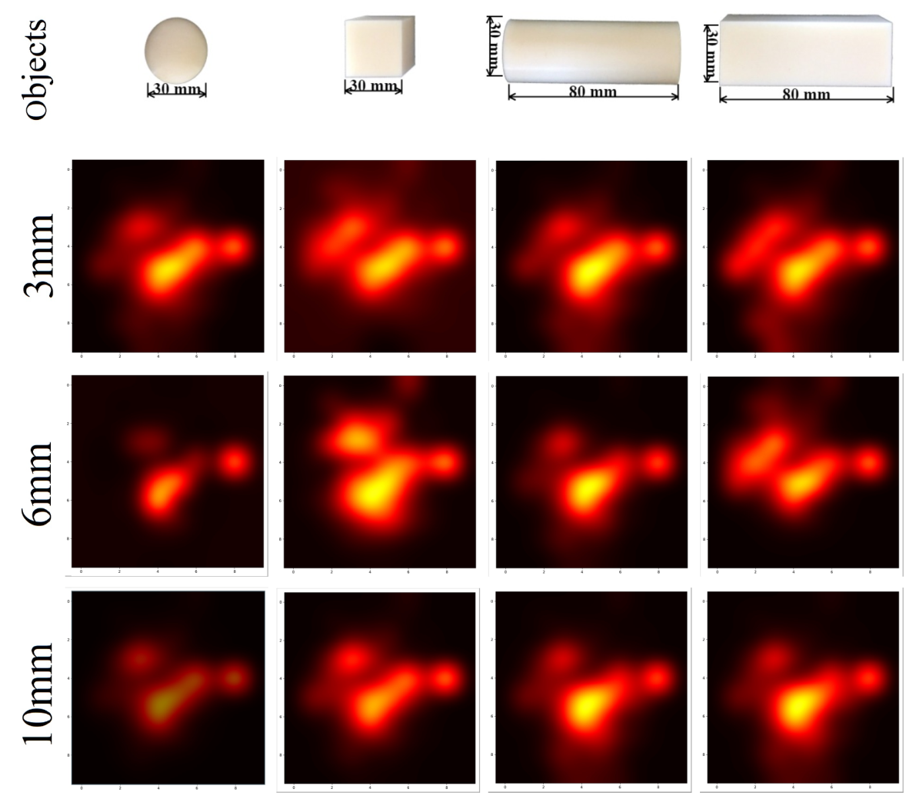


Soft Morphological Processing of Tactile Stimuli for Autonomous Category Formation
Luca Scimeca, Perla Maiolino, Fumiya Iida
ls769@cam.ac.uk, pm640@cam.ac.uk, fi224@cam.ac.uk
Abstract
Experimental Set-up
Sensor morphology is a fundamental aspect of tactile sensing technology. Design choices induce stimuli to be morphologically processed, changing the sensory perception of the touched objects and affecting inference at a later processing stage. We develop a framework to analyze the filtered sensor response and observe the correspondent change in tactile information. We test the morphological processing effects on the tactile stimuli by integrating a capacitive tactile sensor into a flat end-effector and creating three soft silicon-based filters with varying thickness 3mm, 6mm and 10mm). We incorporate the end-effector onto a robotic arm. We control the arm in order to apply a calibrated force onto 4 objects, and retrieve tactile images. We create an unsupervised inference process through the use of Principal Component Analysis and K-Means Clustering. We use the process to group the sensed objects into 2 classes and observe how different soft filters affect the clustering results. The sensor response with the 3mm soft filter allows for edges to be the feature with most variance (captured by PCA and induces the association of edged objects. With thicker soft filters the associations change, and with a 10mm filter the sensor response results more diverse for objects with different elongation. We show that the clustering is intrinsically driven by the morphology of the sensor and that the robot's world understanding changes according to it.
Skin Sensor
R12/5 Robotic Arm
Motivation & Hypothesis
Morphology affects tactile sensor response, pre-processing the sensed stimuli before inference can be done. It is fundamental we understand if and how the influence can change the robot perception of its surroundings.
In the context of morphological processing, we wish to influence the sensor response to retrieve tactile information which simplifies a predetermined, tactile, object discrimination task.
Dimensionality Reduction & Clustering
Raw Tactile Images
Dimensionality Reduction & Clustering
Clusters in PCA subspace
Raw tactile images retrieved when probing each object in turn vertically. The hotter areas are the ones corresponding to tactile taxels detecting a higher pressure. The images are computed over three trials.
From the Raw tactile images, the tactile matrix X is formed. PCA is used to re-encode each object as a 2-dimensional object, considering the two axis of highest variance in the data. Ultimately K-Means Clustering is used to divide the objects into 2 groups.
The projected, 2-dimensional encoding of each probed object and the corresponding Cluster guess after clustering the points through the K-Means Clustering algorithm.
Results
Task Optimization
Autonomous Category Formation Variations
Spatial Resolution Influence
The projected tactile images into the PCA subspace change position according to the soft filter used. The 3 mm filter draws close in space objects with sharp edges, while the thickest soft filter induces the clusters based on object elongation. The phenomenon is due to PCA’s principal components, which are tightly captured to the special filtering induced by the soft filter.
3mm
6mm
The clustering is intrinsically driven by the morphology of the end-effector. Depending on the used soft filter, the Autonomous Category Formation process will form qualitatively different clusters (clusters optimized for different tasks).
Rerunning the experiments over an increasing number of taxels shows the need of a high spatial resolution sensor for the analysis in this paper.
10mm
Notes:
“The title of the paper is Soft- (…)” In this work we address the phenomena of morphological processing through a soft medium (what we call a soft filter). What do I mean by that? What I mean by that is that, in general, we wish our sensors to be functional, thus not to passively gather information from the world, but to take an active part/role into the solving a specific task at hand. So, we investigate how morphology influences the way the robot senses of objects by means of touch, and the possibility of driving that sensing, through morphology, to help the robot solve various object discrimination tasks. So, please come to my stand and I’ll tell you a little more about the research.
Talk about: usually people think processing is done on the brain, we claim finger can categorize

